Slide 1
JCM 2017-10-11 OSCE presentation
TMH
Dr. Li King Yue

Slide 2
Question 1
A 33 year old man, got into a bar fight last night. He do not remember the exact injury mechanism. He noted there was a wound over this hand and thus attended A&E.

Slide 3
What is the most worrying injury mechanism?

Slide 4
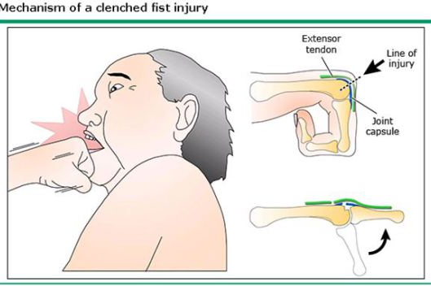
Why is this wound prone to infection?
Fight bite, also called reverse human bite
Infection prone because:
Oral flora
Thin soft tissue overlying the joint and extensor tendon
Retraction of the extensor tendon after relaxation of the fist

Slide 5
Suggest 3 organisms to cover in this kind of wound. (any 3)
Strep Viridans
Gp A Streptococci
Staphylococci aureus
Eikenella corrodens

Slide 6
Suggest appropriate antibiotics
Augmentin preferably IV
Agents lacking activity against Eikenella corrodens should be avoided:
first-generation cephalosporins (such as cephalexin)
penicillinase-resistant penicillins (such as dicloxacillin)
macrolides (such as erythromycin)
Clindamycin alone
aminoglycosides.

Slide 7
Suggest 3 important point in the management other than antibiotics.
Mucosal contact with body fluid management
Hep B/C, HIV screening and FU
Check integrity of extensor tendon, examine in clenched fist position
Copious wound cleansing
Rule out foreign body
ATT

Slide 8
Points to note:
Some patients may hide the mechanism of injury
Tends to present late
Need to proactively recognize this pattern of injury as “fight bite”

Slide 9
Question 2
A 75 year old woman was brought to the A&E department after a syncope episode at home today.

Slide 10
Describe the ECG findings
RBBB
Left Axis deviation
Prolonged PR interval

Slide 11
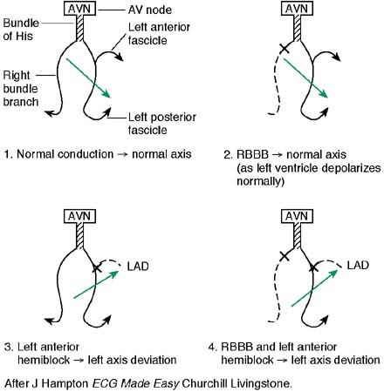
What is the ECG Dx?
“Trifascicular Block”[misnomer]
True Trifascicular block = complete heart block
“Trifascicular Block”=
RBBB
+ LAFB / LPFB [manifested as axis deviation]
+ 1st degree heart block / 2nd degree heart block

Slide 12
Reversible causes to rule out:
Hyperkalemia [reported to cause transient “trifascicular block”]
Digoxin toxicity

Slide 13
Do we need to treat all patients with “trifascicular block”?
Delayed conduction through the last fascicle may imply the last fascicle may also be failing
However, on surface ECG it is not possible to tell whether the delay in conduction is at the AV node or at the remaining fascicle
Overall risk of progressing to complete heart block is thought to be relatively low (1% per year in one cohort study of 554 patients)

Slide 14
Symptomatic “trifascicular block”
In a patient without other accountable cause of syncope, it is possible that they may already had a transient episode of complete heart block during attack
→ pacemaker insertion should be considered

Slide 15
Question 3
You have a 35 year old male patient who is suffering from respiratory failure due to severe asthmatic attack. You want to intubate him with rapid sequence intubation (RSI).

Slide 16
Suggest the best induction agent of choice.
Ketamine
Relieve bronchospasm
Dose: 1-2mg/kg

Slide 17
List 3 contraindications of the use of succinylcholine in RSI.
Muscular dystrophy
Stroke > 72 hours old
Burn >72 hours old
Significant hyperkalemia (with ECG change)
Rhabdomyolysis
Personal or FHx of malignant hyperthermia

Slide 18
What is happening?
After giving the induction agent and succinylcholine, you noticed muscle fasciculation. However, the masseter muscles did not relax as you anticipated. You find it extremely difficult to open the mouth.
Succinylcholine induced trismus / Masseter muscle rigidity (MMR)

Slide 19
What is the most important initial management?
Maintain ventilation with BVM
Trismus may improve / subside after drug effect wear off

Slide 20
What can you do to relax the masseter muscles?
Given standard dose of non-depolarizing neuromuscular blocking agent is reported to improve the trismus

Slide 21
What is happening?
After you managed the airway, the patient later on developed hyperthermia, and worsening acidosis.
Malignant hyperthermia (MH)

Slide 22
What can trigger MH?
Volatile anesthetic agent
halothane, enflurane, isoflurane, sevoflurane, desflurane
Succinylcholine alone can trigger MH
Case series:
20 out of 129 patients who were biopsy-proven MH-susceptible (MHS) developed MH triggered by succinylcholine alone

Slide 23
What are the useful clues to recognize MH?
Masseter muscle rigidity is the most early sign
Generalized muscle rigidity
Worsening hypercarbia [gradually elevating ETCO₂]
Tachycardia and autonomic instability
Hyperthermia
Worsening metabolic acidosis
Rhabdomyolysis & myoglobinuria (late)

Slide 24
What is the most useful treatment for this condition?
Dantrolene

Slide 25
Question 4
30/M presented to the A&E department for a syncope attack while running to catch a bus earlier today. He enjoyed good past health. This is his first episode of syncope, which was preceded by lightheadedness. He had several episodes of lightheadedness while jogging before but without loss of consciousness.
Vital signs:
BP 108/68 mmHg
P 70 bpm
SpO₂ 99 % RA

Slide 26
ECG

Slide 27
Question 1
Other than acute ischemia and dysthymias, suggest 5 important ECG diagnoses to look for in a patient with syncope.
Woff Parkinson White syndrome
2⁰ or 3⁰ Heart Block
“trifascicular block”
Brugada syndrome
Hypertrophic cardiomyopathy
Arrythymogenic Right Ventricular dysplasia
Prolonged QT
Can you describe the ECG features of each of these?

Slide 28
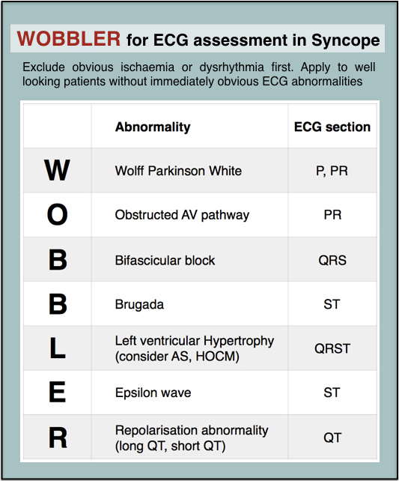
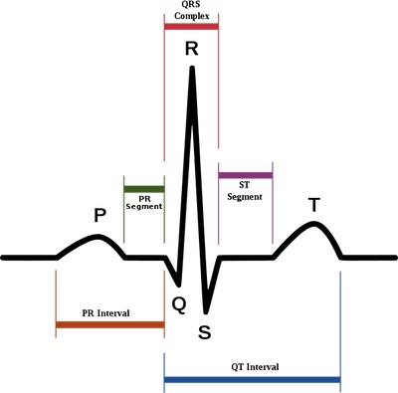
Think from P..QRS..T

Slide 29
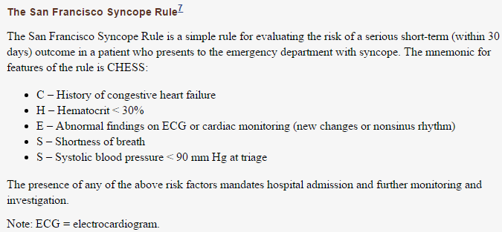
Suggest a clinical prediction rule that can be useful in assessing patient with syncope.

Slide 30
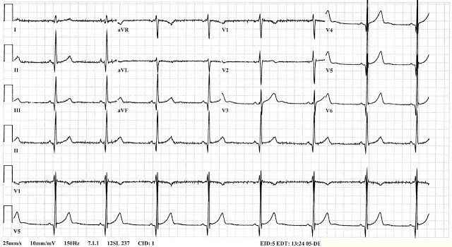
Interpret the ECG.
LVH by voltage
LVH by voltage
Narrow Q wave in II, III, aVF, V4-6

Slide 31
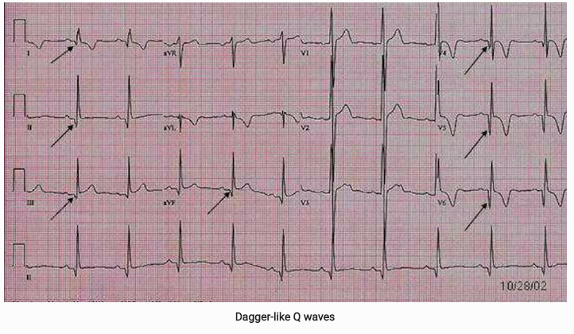
ECG features of HCM
Narrow deep Q wave at lateral leads (I, avL, V5-6)
May confuse with previous MI changes
However, HCM Q wave typically < 40ms

Slide 32
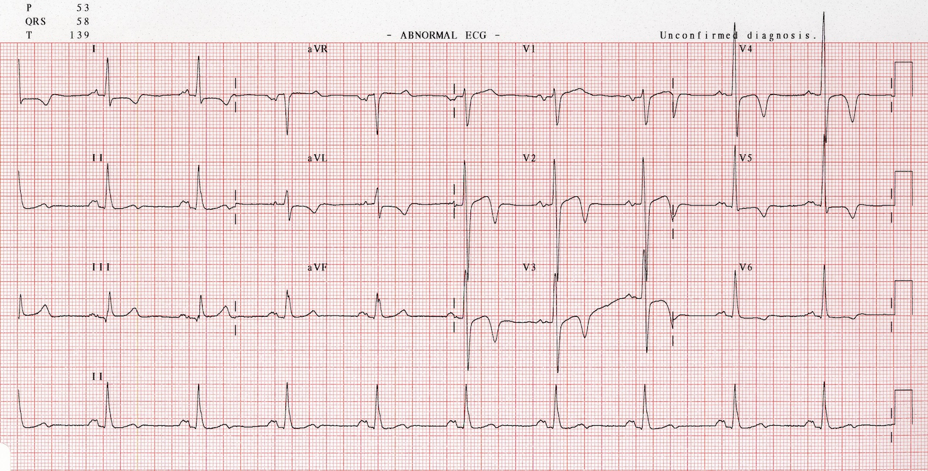
ECG feature of HCM
Evidence of Lt atrial enlargement (P mitrale)

Slide 33
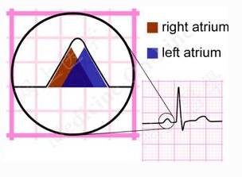
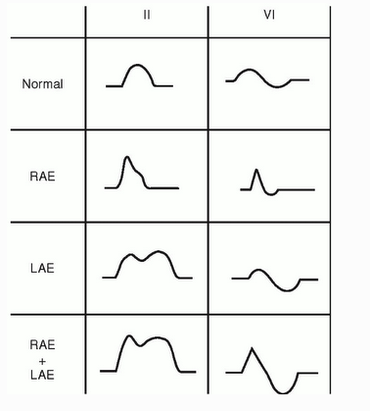
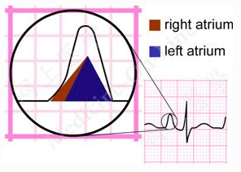
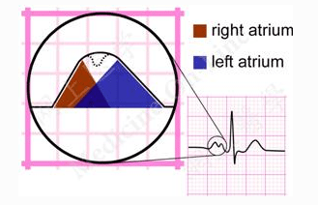
P wave interpretation
Normal
Rt atrial enlargement
Lt atrial enlargement

Slide 34
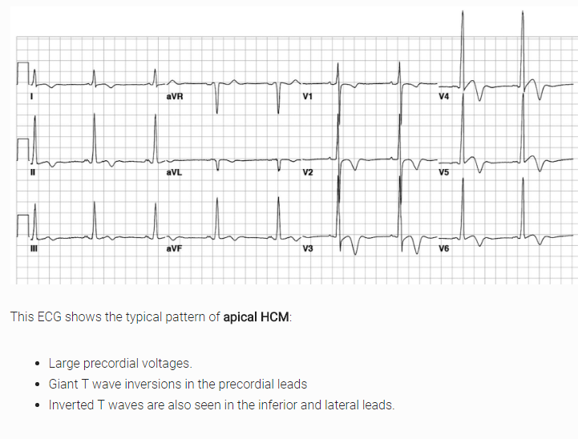
ECG feature of HCM

Slide 35
Together with the presenting symptoms, what diagnosis should you suspect?
Hypertrophic cardiomyopathy (HCM)

Slide 36
Types of HCM
Asymmetrical anterior septal hypertrophy
Most common type
May have dynamic LVOT obstruction (25%only)
Hence the name changed from HOCM to HCM!
Other types:
Concentric (20%)
Apical (10%)
(more common in Japan, also named Yamaguchi cardiomyopathy)
Notes:
Optional slide – skip if time tight

Slide 37
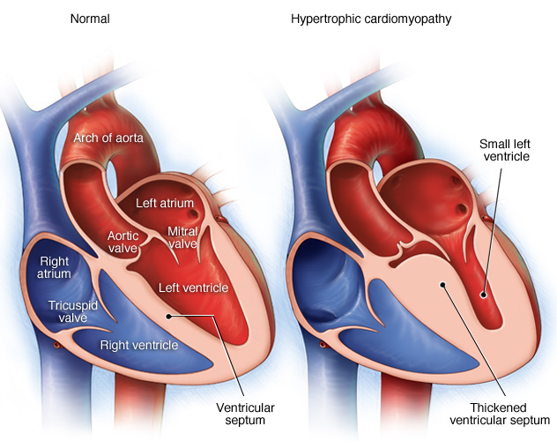
Problems with HCM
Dynamic LVOT obstruction
Poor LV compliance and diastolic dysfunction
Abnormal intramural coronary arteries resulting in ischaemia
Chaotic & disorganized LV architecture prone to arrhythmia
Notes:
Optional slide – skip if time tight

Slide 38
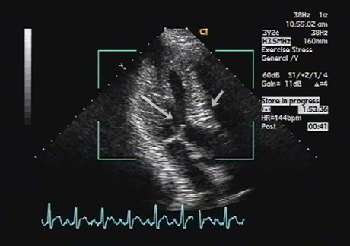
Suggest the most appropriate investigation to rule in your provisional diagnosis.
Echocardiogram:
Readily available
Unexplained max. wall thickness >15mm
Symptoms and ECG finding may precede the echo finding
Cardiac MRI is a better assessment tool

Slide 39
What treatment can be considered if the patient had recurrent syncope after the diagnosis was confirmed?
Automated Implantable Cardioverter-Defibrillator (AICD)
AICD for 1⁰ prophylaxis if >= 2 ( or >=1 risk factor with *) of the following:
Max LV thickness >=30mm*
FHx of SCD <40 years old*
Unexplained syncope*
Holter revealed non-sustained VT
Abnormal BP response to exercise

Slide 40
The end

